Slide 1
How to sign eWaivers
You will see the following at the end of your registration page
Important that you select this option before you click on Register
so that you can sign the electronic waiver

Slide 2
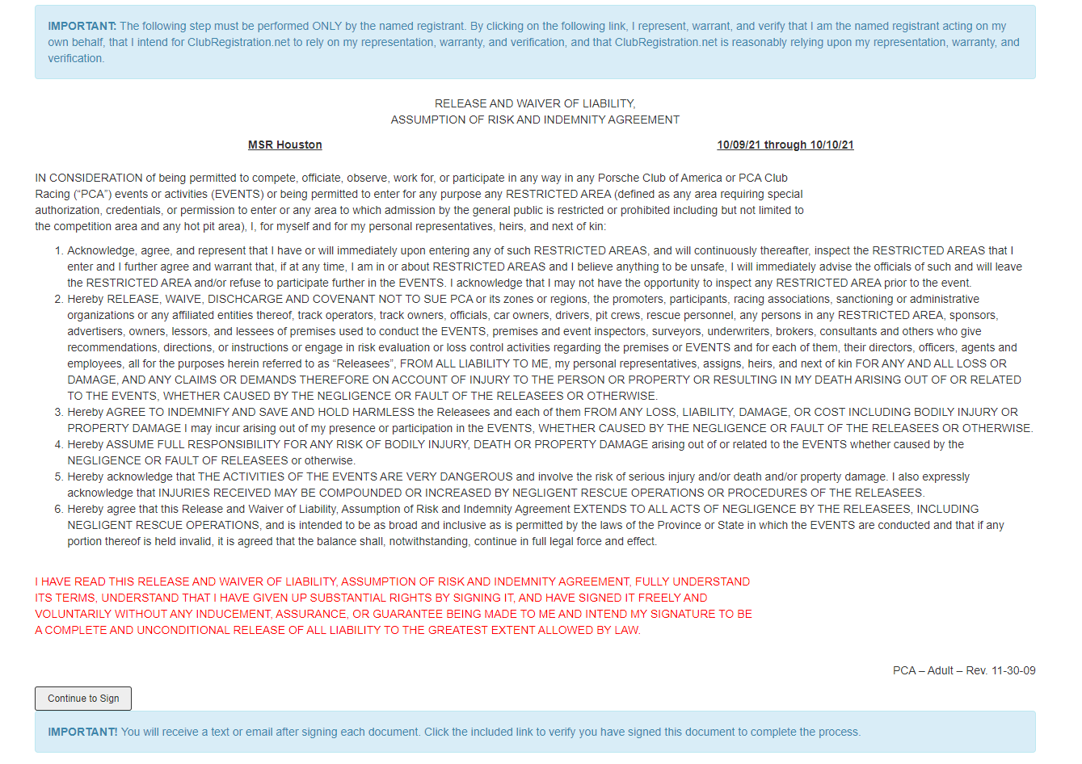
Once you read the Waiver of Liability click here. A signature box will open for you to sign.
Once you submit your signature you will get an email or text that you will need to open
for confirmation.

Slide 3
It is important that both steps are highlighted blue after you complete
the process, otherwise you are missing a signature or its verification and
will not receive event confirmation.

